Slide 1

Natural Language Processing: Introduction to Transformers
Mina Farmanbar
Associate Professor, University of Stavanger
for engineers

Slide 2
What is a large language model?
A large language model is a deep learning model.
Trained on extensive text data.
Performs NLP tasks like text generation, question answering, and translation.
Uses Transformer architecture.
Examples include Google’s BERT.
Leverages billions of words from diverse sources for versatile outputs.

Slide 3
Architecture of large language models
Large language models use the Transformer architecture.
Example: OpenAI’s GPT-3.
The Transformer architecture is a type of deep learning.

Slide 4
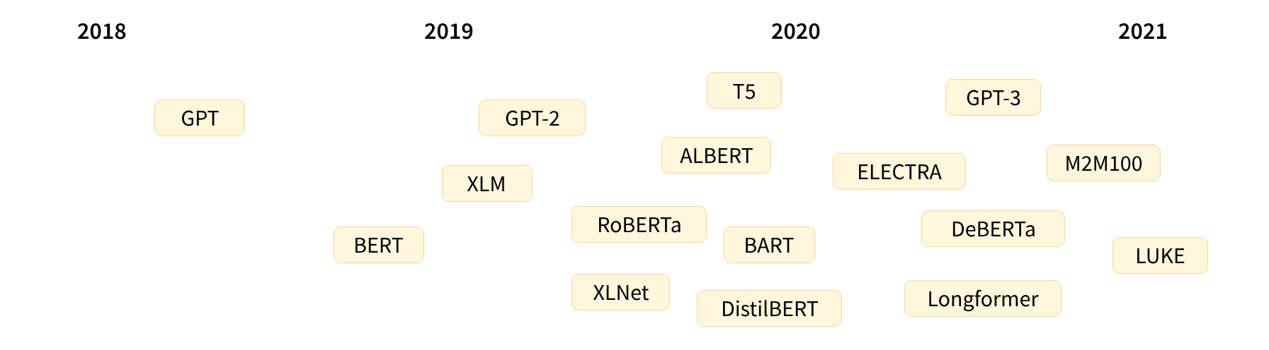
Transformers
The Transformer architecture was introduced in June 2017.
Initially focused on translation tasks.
https://huggingface.co/datasets/huggingface-course/documentation-images/resolve/main/en/chapter1/transformers_chrono.svg

Slide 5
Transformers
Transformers can be grouped into three categories:
Transformers are language models!
This means they have been trained on large amounts of raw text.
Self-supervised learning
Self-supervised learning is a training method in which the model learns to predict part of its input data from other parts of the same data.
No human labeling!!!
Auto-regressive
Auto encoding
Seq-to-seq
GPT-like
BERT-like
BART/T5-like

Slide 6
Transfer learning
Is a process in which the model is fine-tuned in a supervised way — that is, using human-annotated labels — on a given task.
An example of a task is predicting the next word in a sentence having read the n previous words.
This is called causal language modeling because the output depends on the past and present inputs, but not the future ones.

Slide 7
Transfer learning
Pretraining:
Training a model from scratch with random weights.
Fine-tuning:
Training a pretrained model on task-specific data.
Benefits of fine-tuning:
Less data, time, and resources required compared to training from scratch.

Slide 8
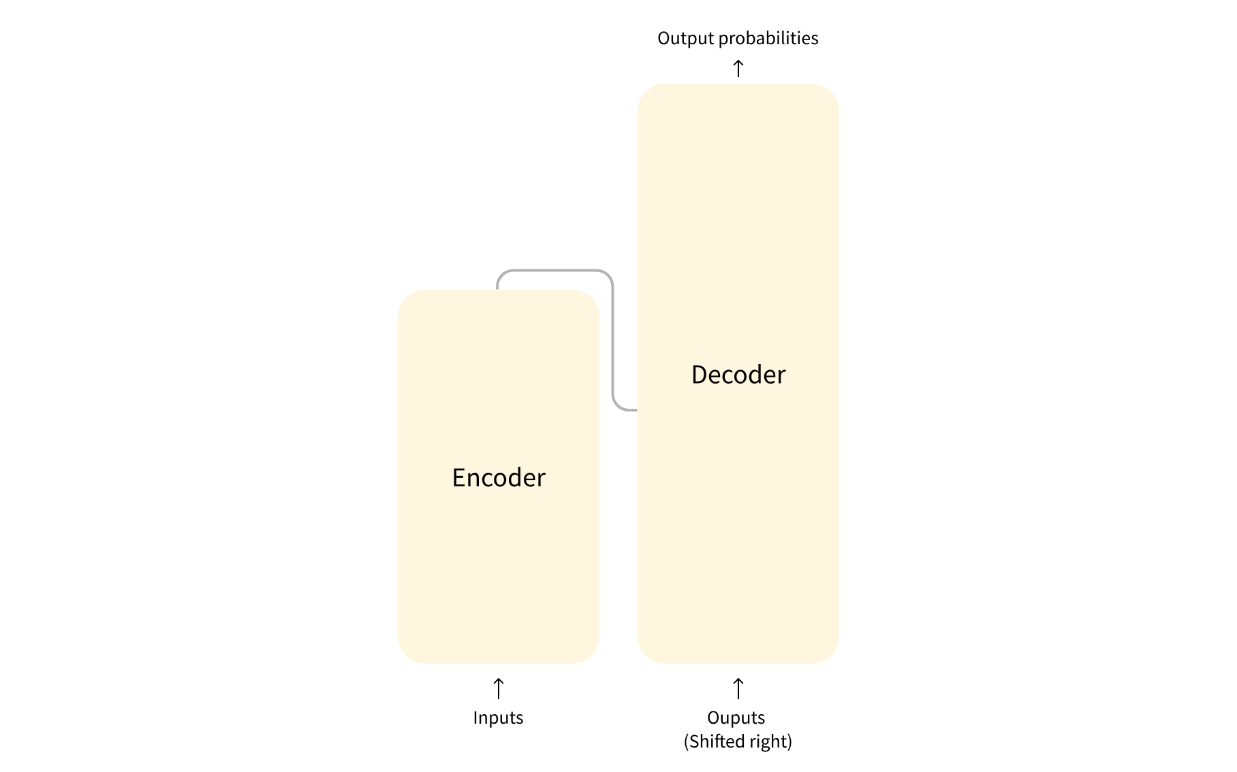
Transformers
The model is primarily composed of two blocks:
Encoder:
Processes input, creates representation.
Decoder:
Generates output based on encoder's representation
Text generation
Sentence classification
Named entity recognition
Translation
Summarization
Transformer Architecture

Slide 9
Attention layers
A key feature of Transformer models is that they are built with special layers called attention layers.
When humans read any text, we take in the text word by word or sentence piece by sentence piece.
Subject/Verb
Tense
Topic
Style of writing

Slide 10
Attention layers
Attention layers will enable the model to look for certain patterns in sentences.
They will learn to make connections between different words in a sentence which are important for its meaning.
Attention Layer
Attention Layer
Attention Layer
Attention Layer
Attention Layer
Attention Layer
Attention Layer
Attention Layer
Multi-head Attention Layer
Attention Head

Slide 11
Attention layers
Feed-Forward Network
Attention Layer
Subject/Verb
Attention Layer
Object/Location
Attention Layer
Tense
Attention Layer
Language
Multi-head Attention Layer
Attention Head

Slide 12
Attention layers
In fact, they use six multi-head attention layers stacked on top of each other, each paying attention to more general concepts as data progresses through the model.

Slide 13
Summary
Discussed how Transformer models work at a high level
Talked about the importance of transfer learning and fine-tuning
Key aspect:
Use the full architecture or only the encoder or decoder
Depends on the task you aim to solve

Slide 14
Thank you!
Mina Farmanbar
mina.farmanbar@uis.no

